Slide 1

STYLE-X

Slide 2

A TEAM- 1 PRESENTATION
STYLEX

Slide 3
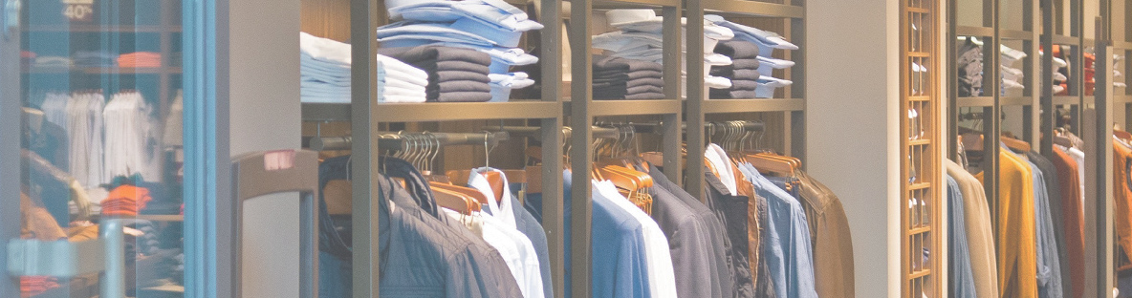
About Us
STYLEX
Welcome to Style-X: Elevating Your Luxury Rental Experience
At Style-X, we believe that luxury is not just about owning exquisite items; it's about the experience they bring. With our innovative rental platform, we offer a seamless and personalized approach to accessing the world's most prestigious brands and designers. Whether you're a fashion enthusiast, a trendsetter, or a renowned brand, Style-X caters to your needs with precision and sophistication.

Slide 4
TABLE OF CONTENTS
BRM, SIPOC, USER ROLES
CONTEXT DIAGRAM ; SYSTEM INTERFACE TABLE
USER STORIES (CONSTRAINTS & EXCEPTIONS)
ROAD MAP(S1,S2,S3) ; LIST OF STORY TASKS AND JIRA
RTM/RCT
UML DIAGRAMS( ACTIVITY AND SEQUENCE)
BURNDOWN CHARTS (S1,S2,S3)
ER DIAGRAM
JENKINS PROGRESS REPORT (S1,S2,S3) & JENKINS DEMO
APPLICATION DEMO

Slide 5

BRM , SIPOC AND USER ROLES
STYLEX
DHIVYA NIKHIL

Slide 6
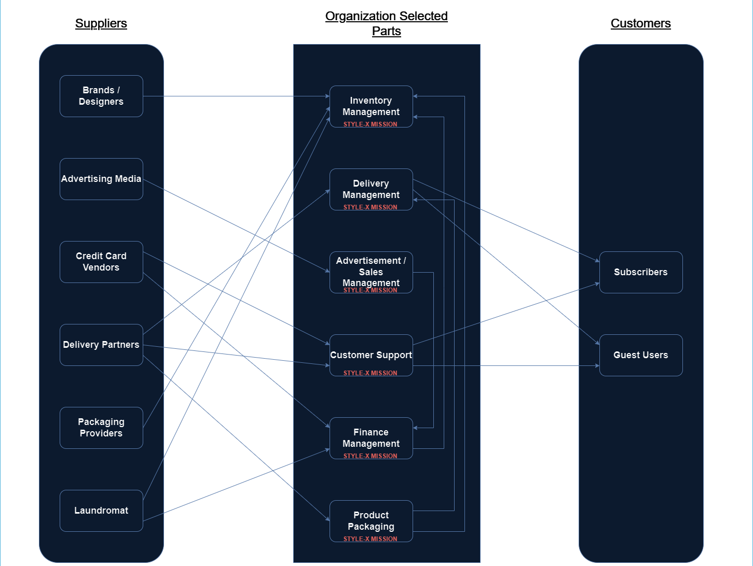

B
R
M
StyleX Mission
StyleX Mission

Slide 7
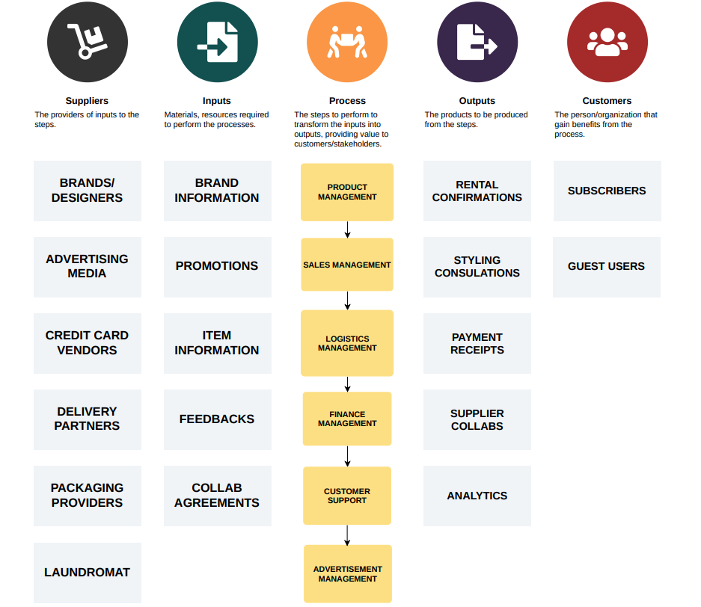
SIPOC MODEL

Slide 8
USER ROLES BY BUSINESS GROUPS
EXTERNAL USERS:
USER ROLES | TEAM MEMBERS
Subscribed Users | Sharath, Vineet
Guest Users | Rohith, Kalpana
INTERNAL USERS :
INTERNAL USERS:
BUSINESS GROUP | USER ROLES | TEAM MEMBERS
Inventory Management | Inventory Analyst Inventory Coordinator | Anirudh , Nikhil
Delivery Management | Logistics Manager Delivery Operations Specialist | Sakshi , Dhivya
Sales Management | Sales Strategist Account Manager | Anirudh, Ram Prakash
Customer Support | Customer Service Representative Support Team Lead | Aisha , Honghao
Finance Management | Financial Analyst Financial Transactions Coordinator | Somil , Nikhil
Product Packaging | Packaging Designer Packaging Operations Manager | Sivasai, Gauri

Slide 9

CONTEXT DIAGRAM & SYSTEM INTERFACE TABLES
STYLEX
SAKSHI

Slide 10









STYLEX
Inventory
Subscribers/Guest Users
Delivery
1
Inventory Management
Delivery Management
2
Subscriber's & Guest Users interact with system for purchases and various reasons
Provides confirmation purchase receipt
Brands / Designers
Advertisement /
Sales
Ads/Sales Management
3
External entities or stakeholders
STYLE X
Advertising Media
Manage advertisement space sales
Manage advertisement feed
Helps Users with service-related issues
Customer Assistance
transaction status, & credit card-related services
Customer Support
Customer Service
4
Financial Management
Product Packing
Financial Control
Credit Card Vendors
6
5
Order Packing

Slide 11
STYLEX
System Interface Table (SIT)
No | Description | Source | Target | Frequency | Validation
1 | Inventory Management | Warehouse Inventory | STYLE X | Real-time | The item is allocated to a certain order ID and once purchased the inventory itself updates inventory left and adds back when returned.
2 | Delivery Management | Delivery Services | STYLE X | Real-time | Order information & delivery partner’s details with its real-time status.
3 | Ads/Sales Management | Advertising & Sales Media | STYLE X | Real-time | Advertisements and recommendations when user enters Style X webpage.
4 | Customer Support | Support | STYLE X | Real-time | User will have flexibility to contact us 24/7 and its available all over the system interface.
5 | Financial Management | financial administration | STYLE X | End of the day | Offers a dashboard with tools for transactions, budgeting, and secure payments, ensuring efficient tracking and management of financial activities.
6 | Product Packing | Package Services | STYLE X | Real-time | Enables internal staff to efficiently log and track rented items, generate shipping labels, and ensure accurate inventory management, streamlining the packing and shipping process for their rental garments.

Slide 12
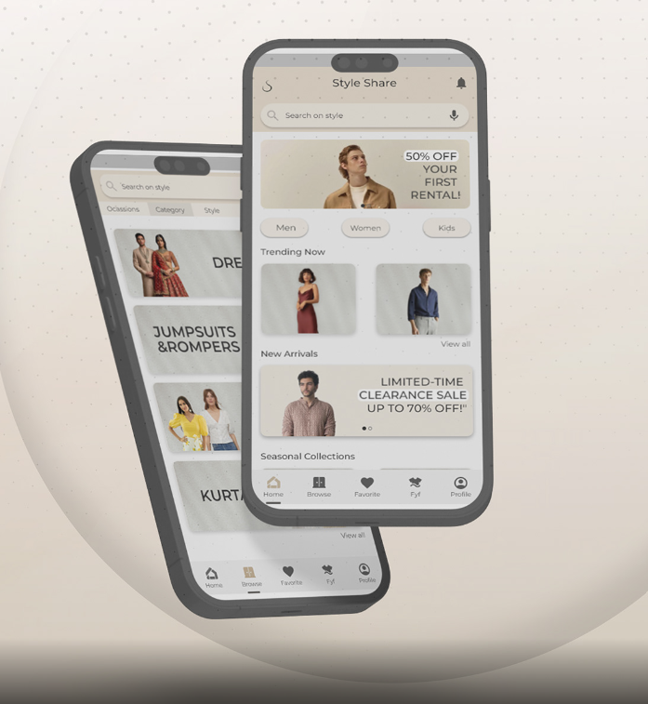
USER STORIES [ EXCEPTIONS & CONSTRAINTS]
STYLEX
VINEET

Slide 13
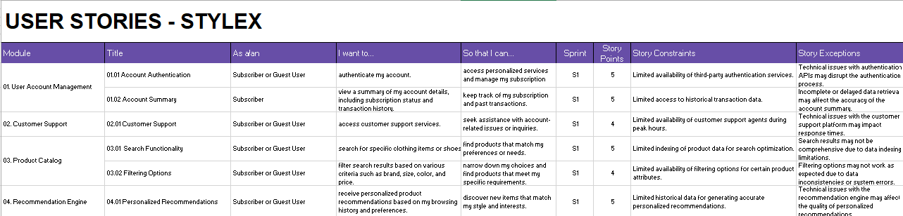

Slide 14

ROADMAP, LIST OF STORY TASKS & JIRA – KANBAN BOARD
ROHITH
STYLEX

Slide 15
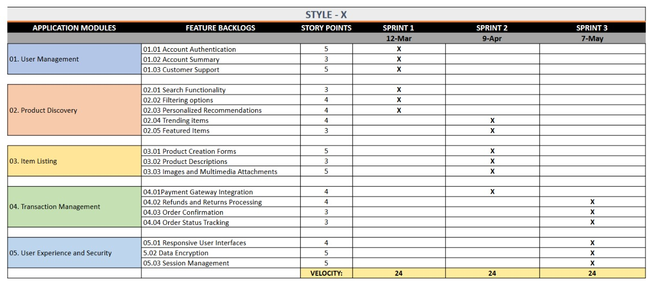
ROADMAP

Slide 16
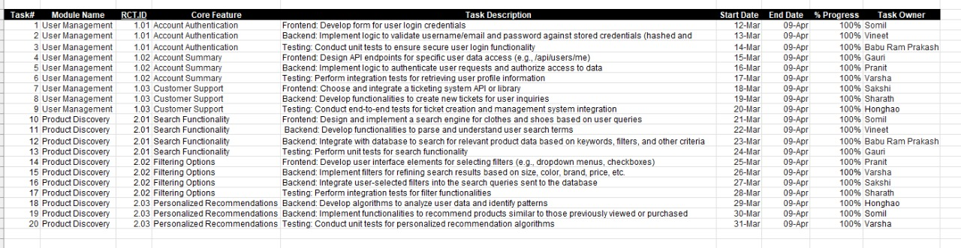
LIST OF STORY TASKS SPRINT 1

Slide 17
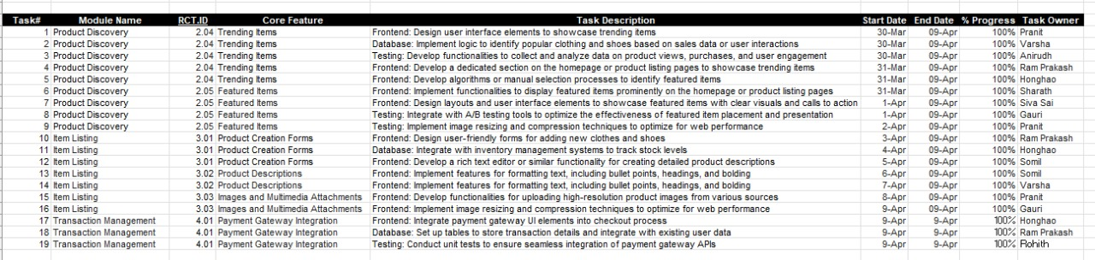
LIST OF STORY TASKS SPRINT 2

Slide 18
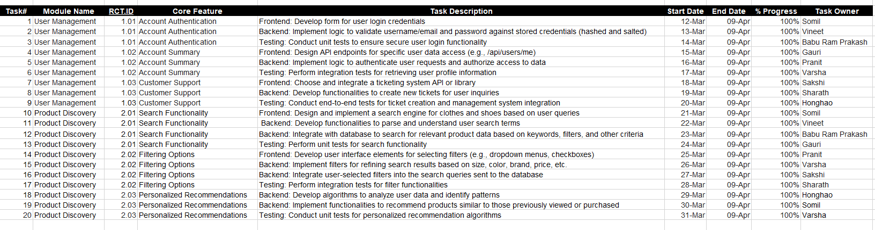
LIST OF STORY TASKS SPRINT 3

Slide 19
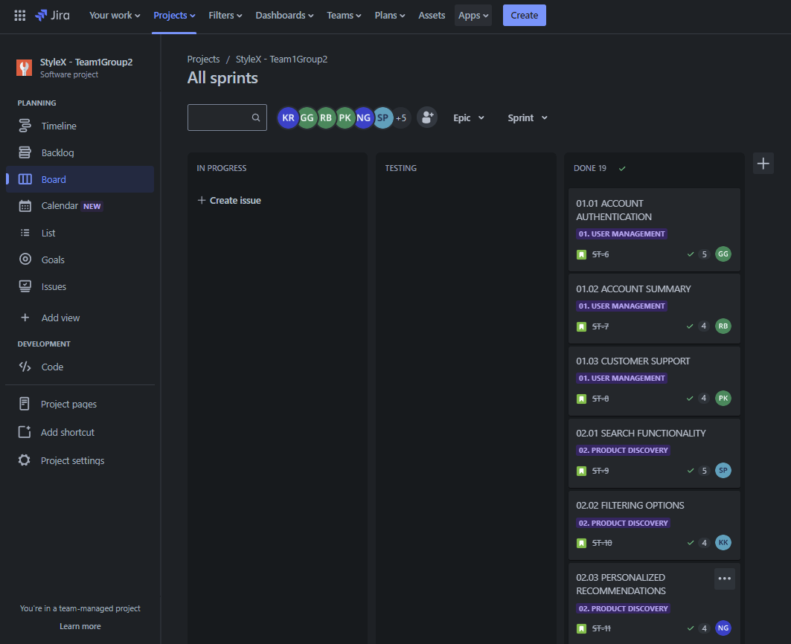
JIRA KANBAN BOARD

Slide 20
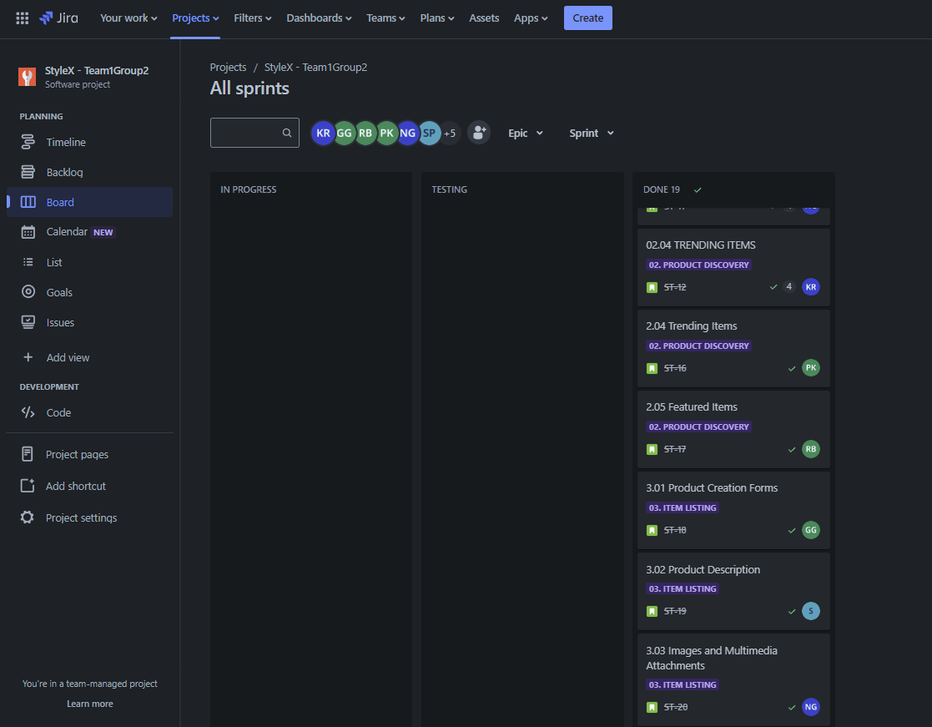
JIRA KANBAN BOARD

Slide 21
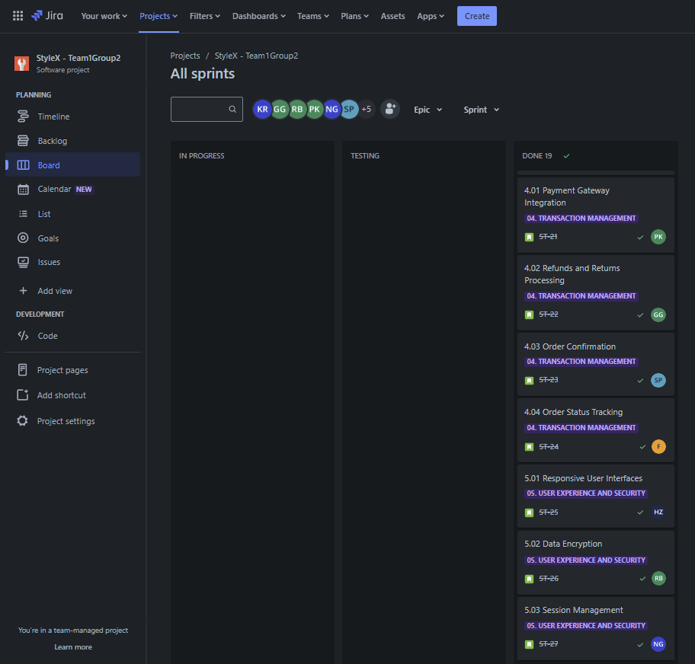
JIRA KANBAN BOARD

Slide 22
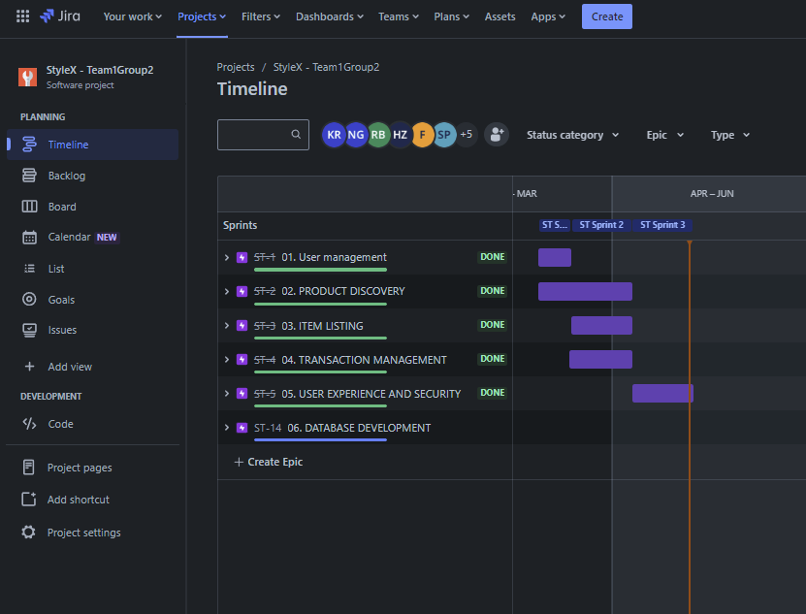
JIRA ISSUE TIMELINE

Slide 23
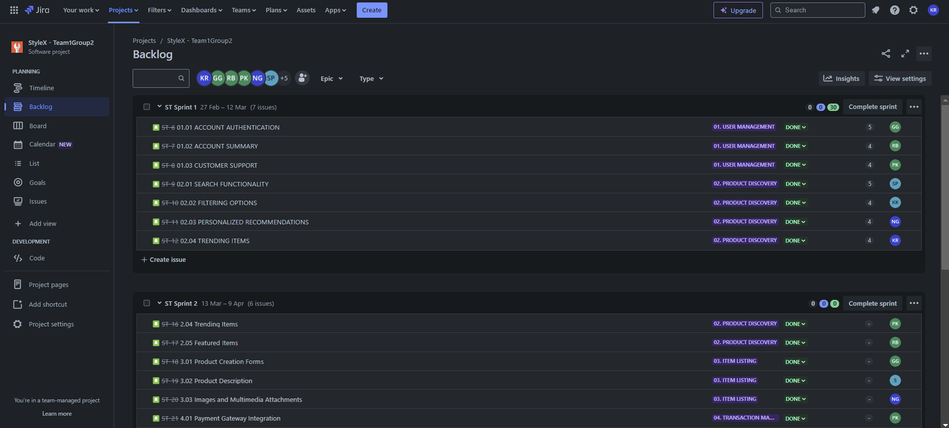
JIRA BACKLOG TABLE

Slide 24
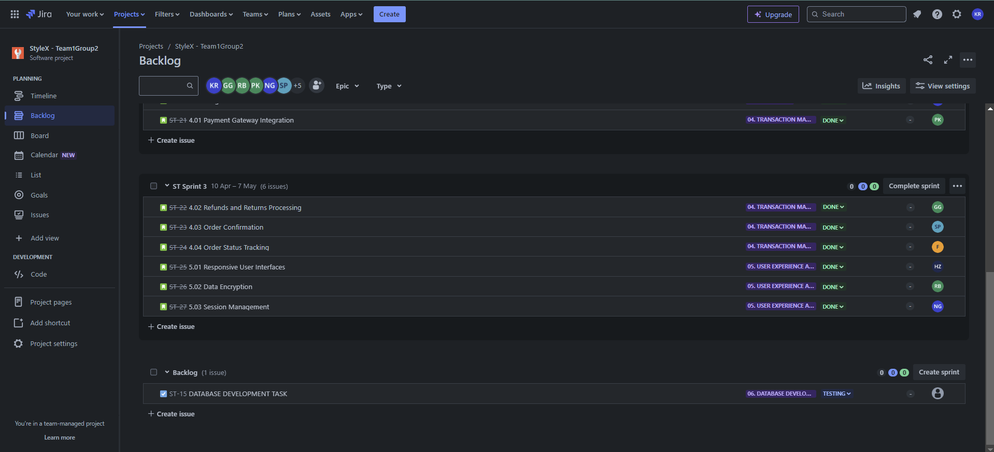
JIRA BACKLOG TABLE

Slide 25

RTM / RCT
KALPANA SHARATH
STYLEX

Slide 26
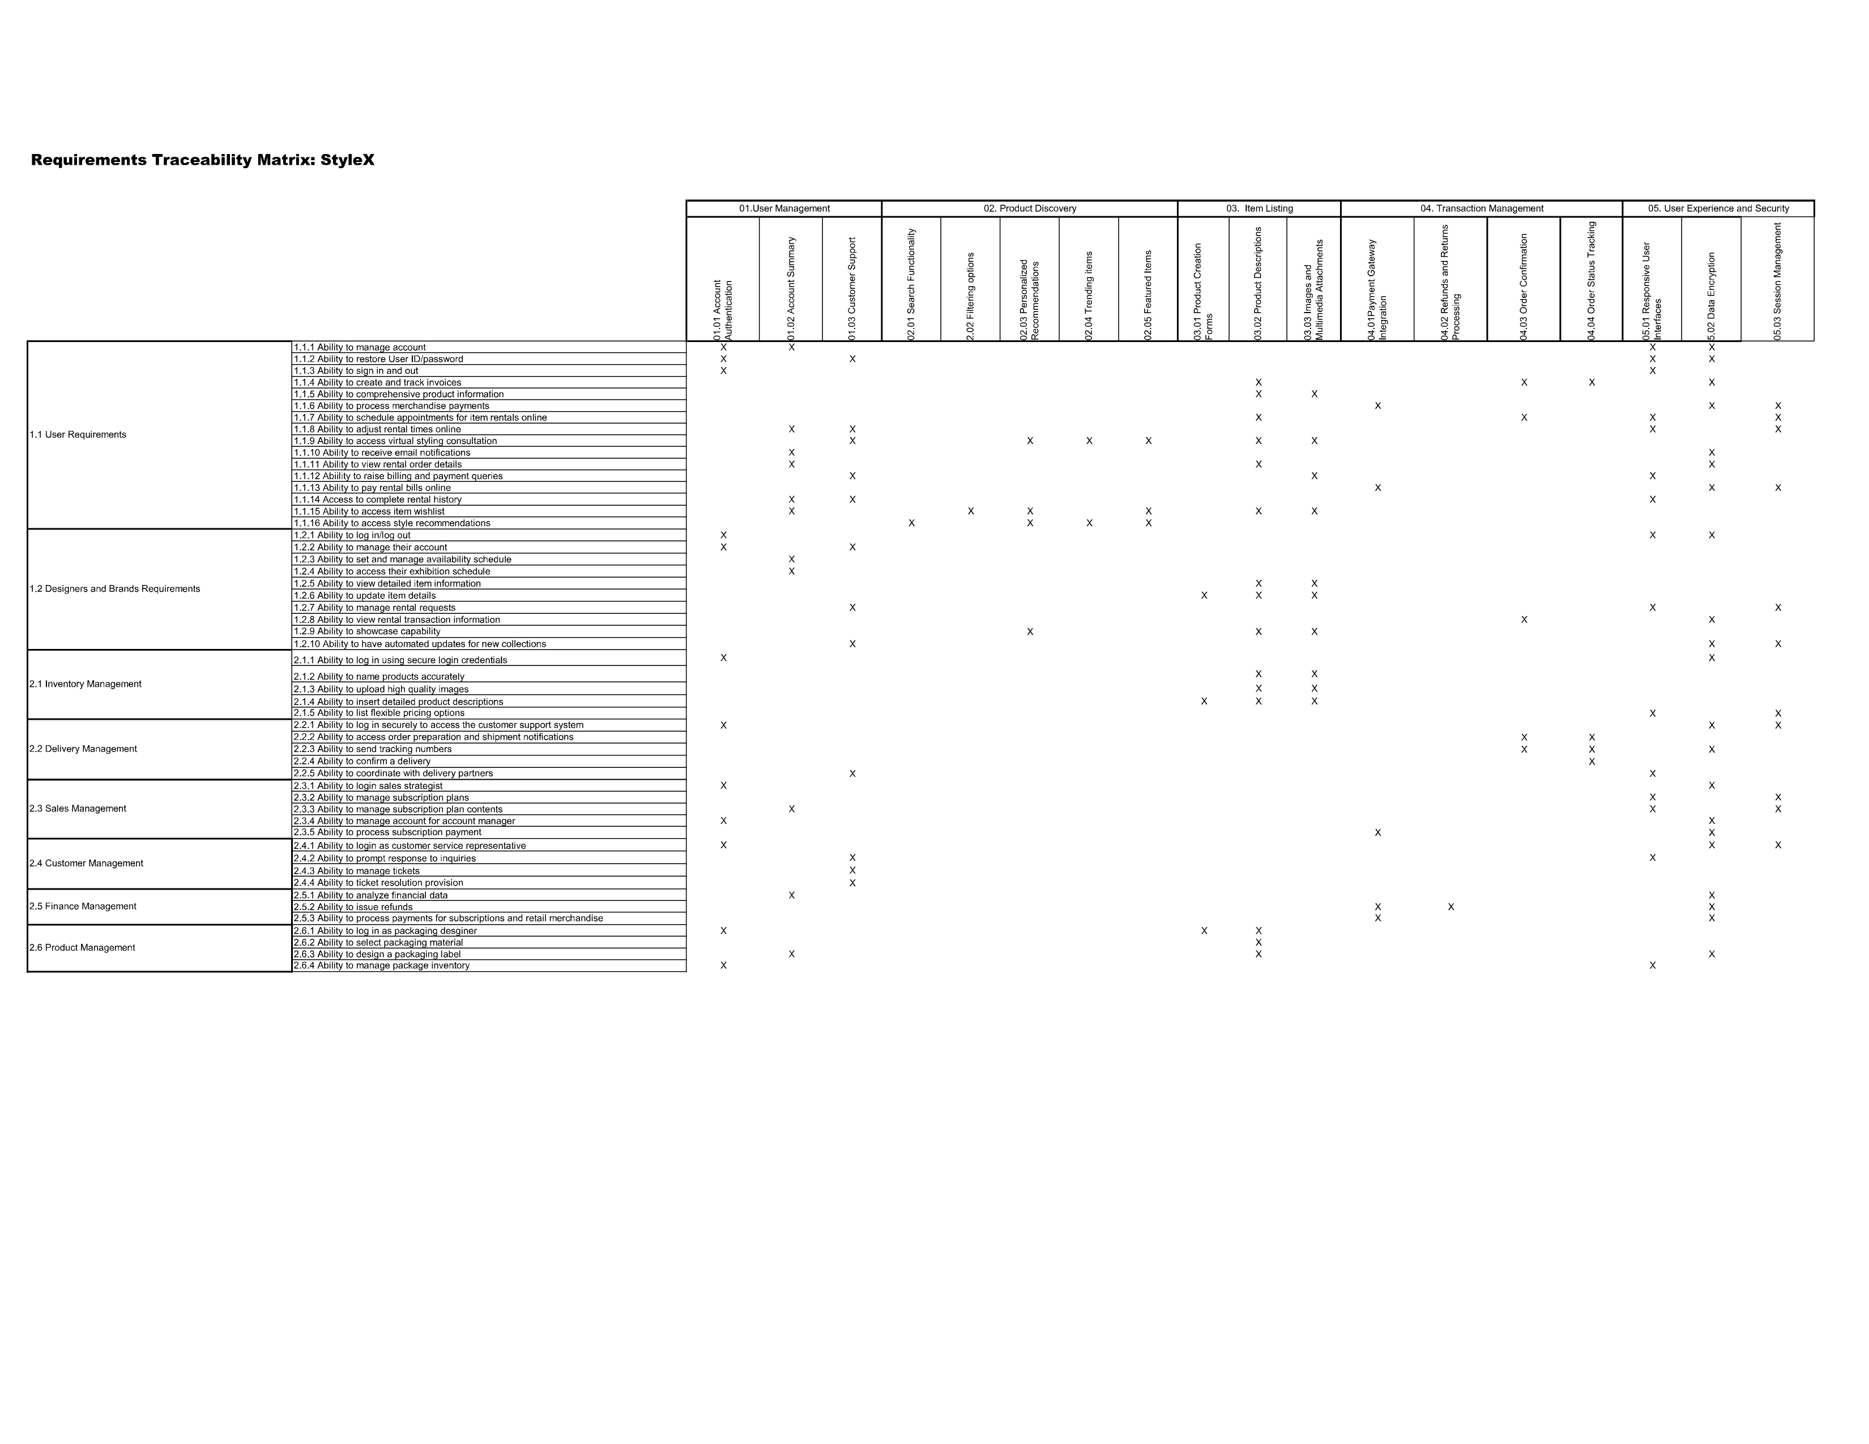

Slide 27
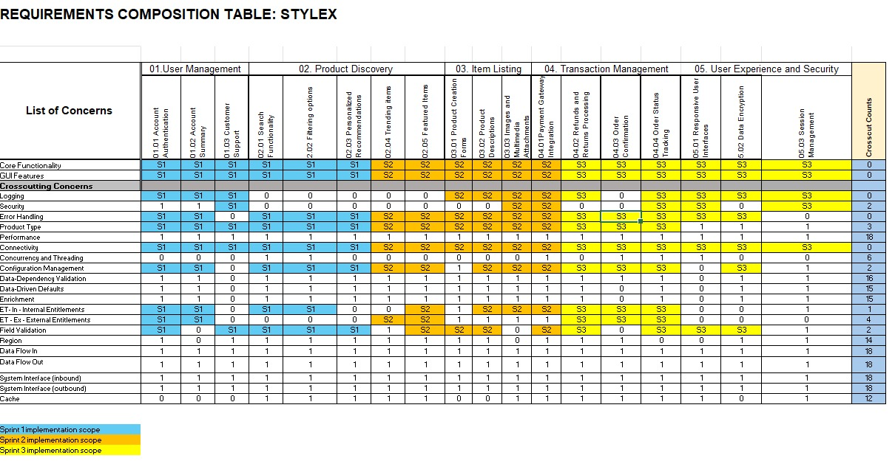
RCT

Slide 28
UML DIAGRAMS (I) ACTIVITY (II)SEQUENCE
BABU RAM PRAKASH SIVA SAI
STYLEX

Slide 29
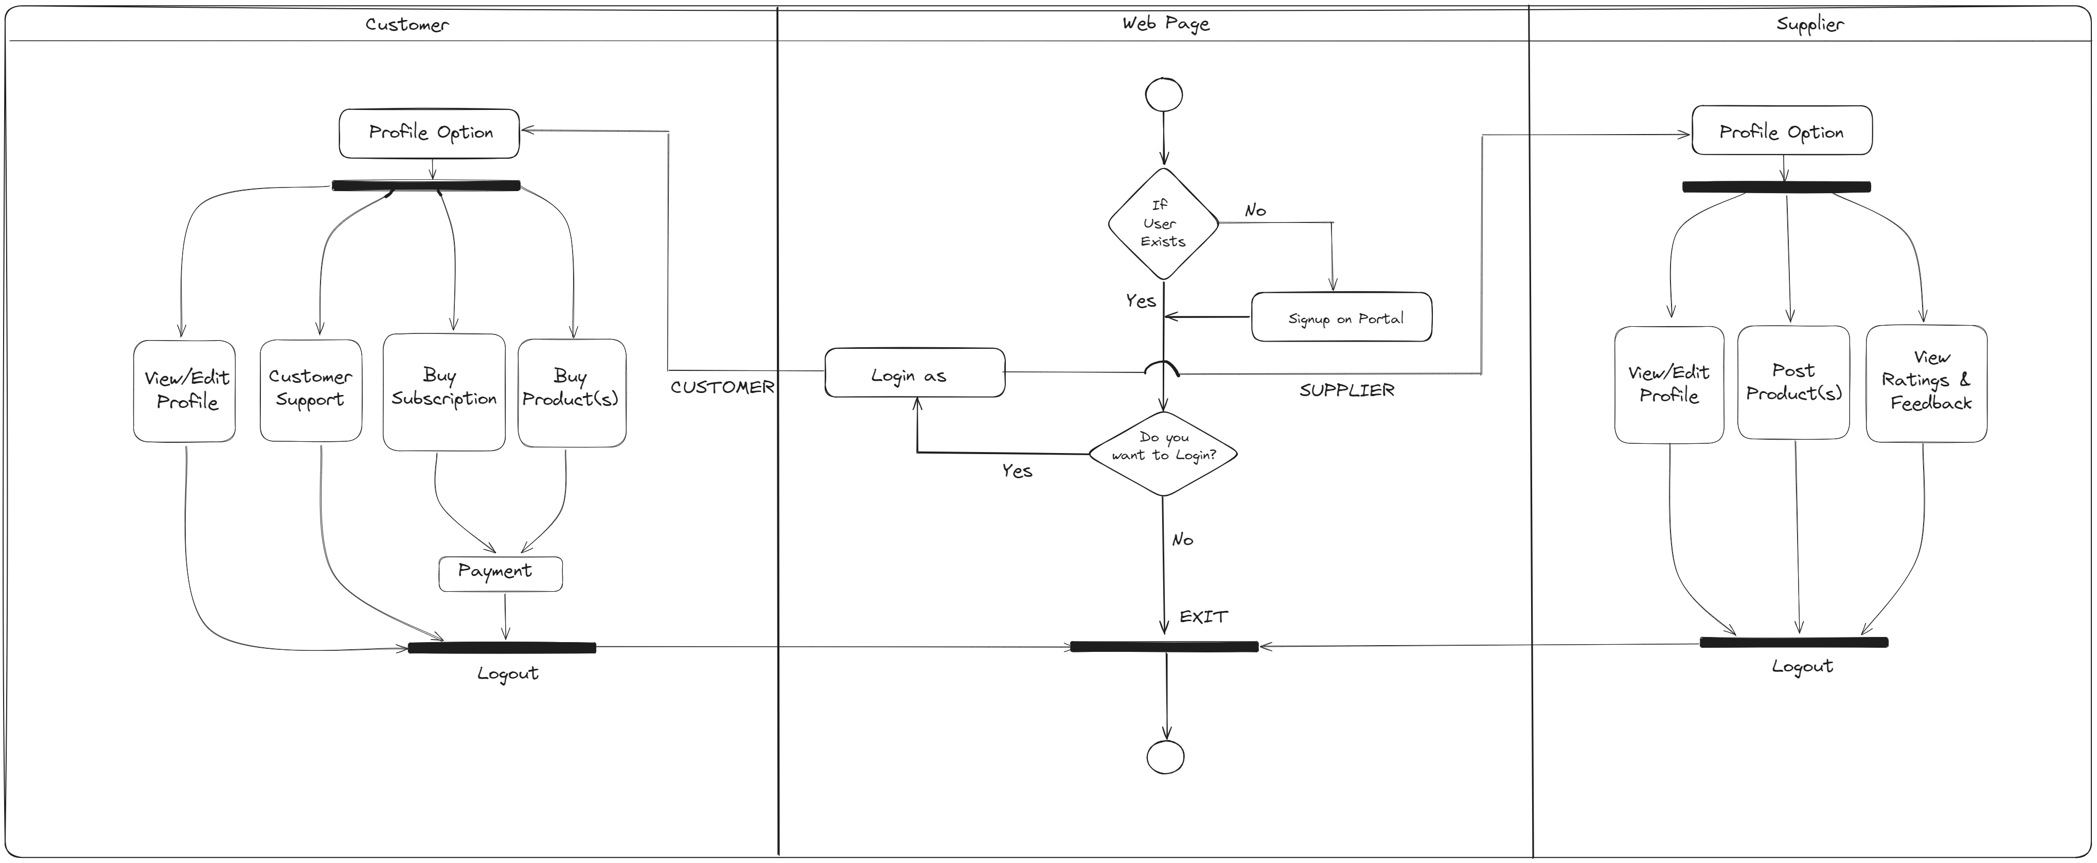
ACTIVITY DIAGRAM

Slide 30

Team 1 Style X UML Sequence for Returns and Refunds
:Login
:Helpdesk
Customer
Use Case Scenario:
Use case begins when user login to their account and opens a ticket to make a return and get a refund.
Customer reaches out to helpdesk and open a ticket and gets it resolved.
The use case ends.
login()
tickets_creation()
login successful
Tickets created
Tickets resolved
logout

Slide 31
Team 1 Style X UML Sequence for Order Tracking
:Payment
:Order
Customer
Use Case Scenario:
Use case begins when user’s payment for an order is successful.
They receive payment validation message as well as tracking details.
User can track the order using the tracking details provided.
The use case ends.
payment_result()
Payment Successful
track_order()
Track order with number provided

Slide 32
Team 1 Style X UML Sequence for Subscription
:Subscription
Customer
Use Case Scenario:
Use case begins when a customer’s subscription is about to end, and they receive a notification.
Customer renews the subscription using supported payment method.
The use case ends.
subscription_enddate()
Notify customer
renewal()
Subscription successfully renewed

Slide 33
Team 1 Style X UML Sequence for Wishlist
:Wishlist
Customer
Use Case Scenario:
Use case begins when a customer wants to have a look at their wishlist.
Customer renews the subscription using supported payment method.
The use case ends.
view_wishlist()
Wishlist displayed

Slide 34
Team 1 Style X UML Sequence for Newsletter
:Newsletter
Sales Strategist
Use Case Scenario:
Use case begins when sales strategist wants to send news to customer.
Customer who are subscribed to newsletter are notified.
The use case ends.
Alert_news()
Customer receives alerts

Slide 35

BURNDOWN CHARTS
HONGHAO KUNJ DESH PATEL
STYLEX

Slide 36
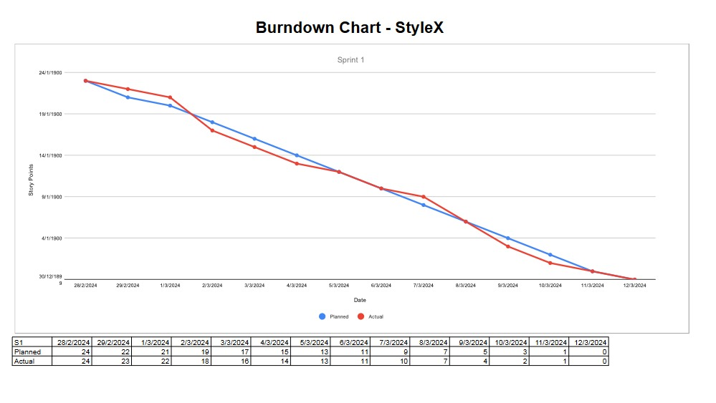
BURN DOWN CHART SPRINT 1

Slide 37
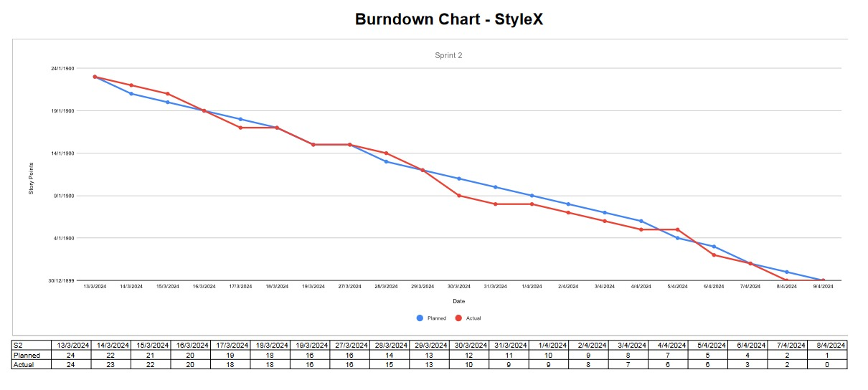
BURN DOWN CHART SPRINT 2

Slide 38
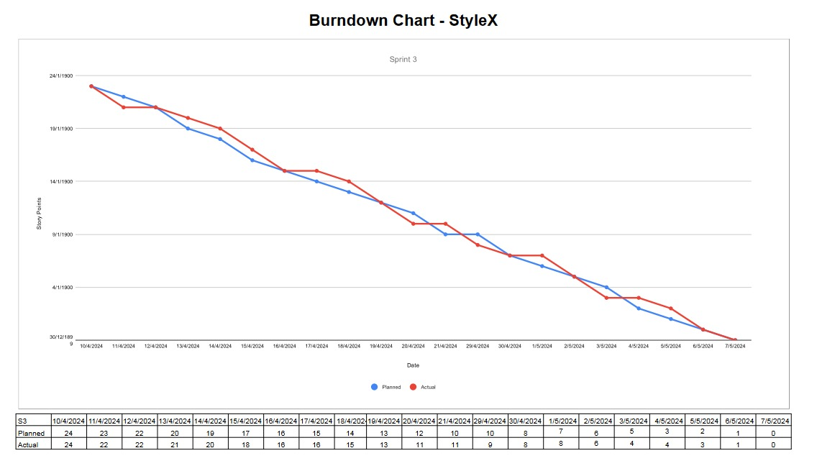
BURN DOWN CHART SPRINT 3

Slide 39

ER DIAGRAM
STYLEX
ANIRUDH VARSHA

Slide 40
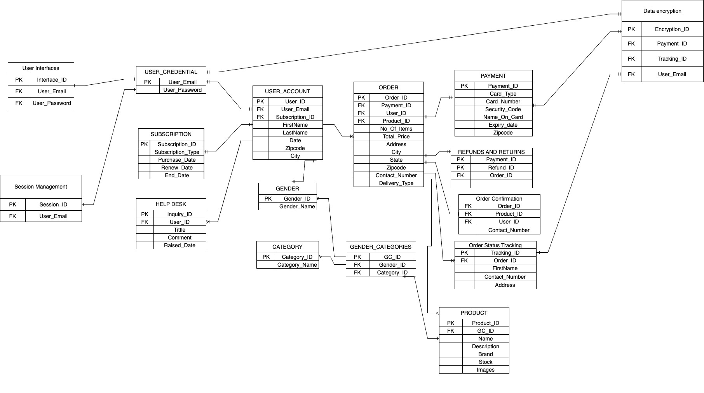
STYLE-X ER-DIAGRAM SCOPE : SPRINT 3

Slide 41

JENKINS PROGRESS REPORT – S1, S2, S3 & JENKINS DEMO
GAURI GUPTA

Slide 42
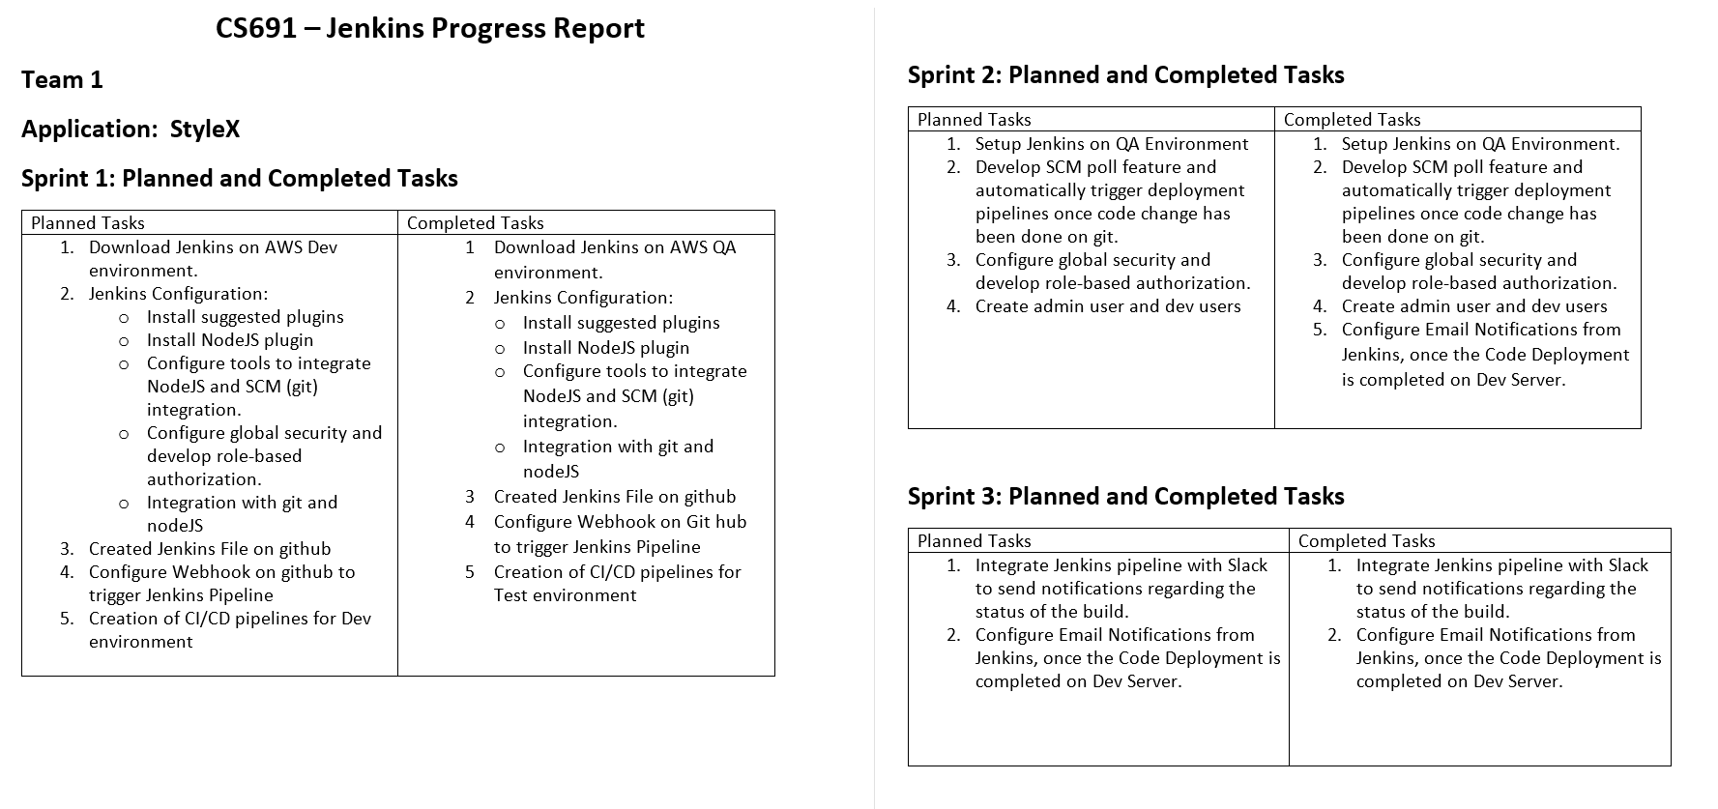

Slide 43
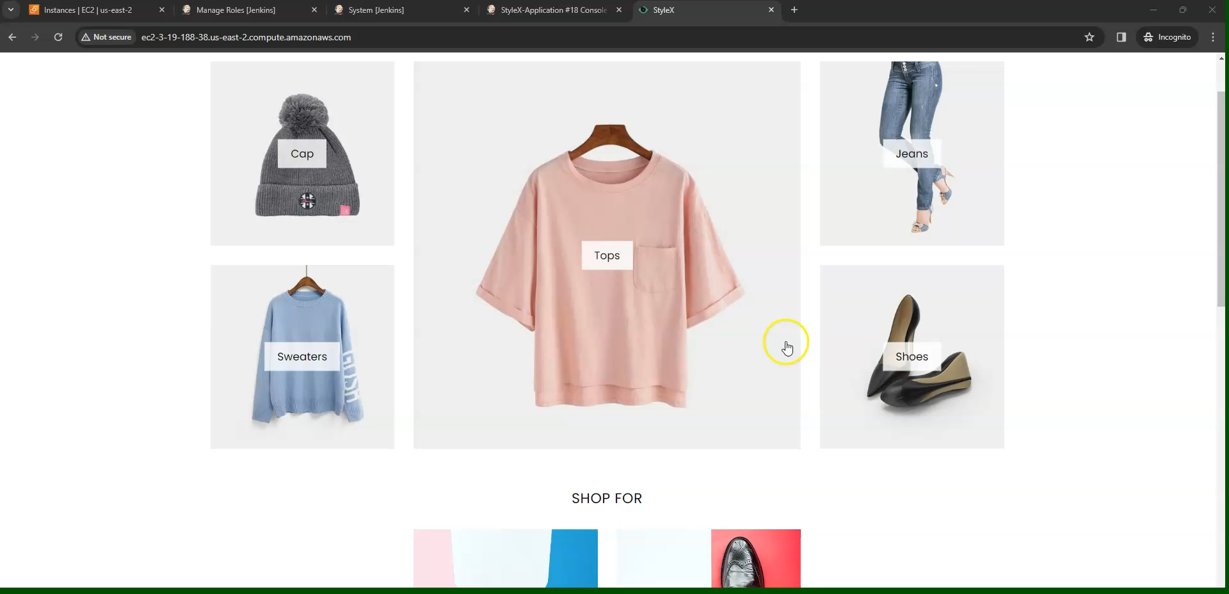

Slide 44
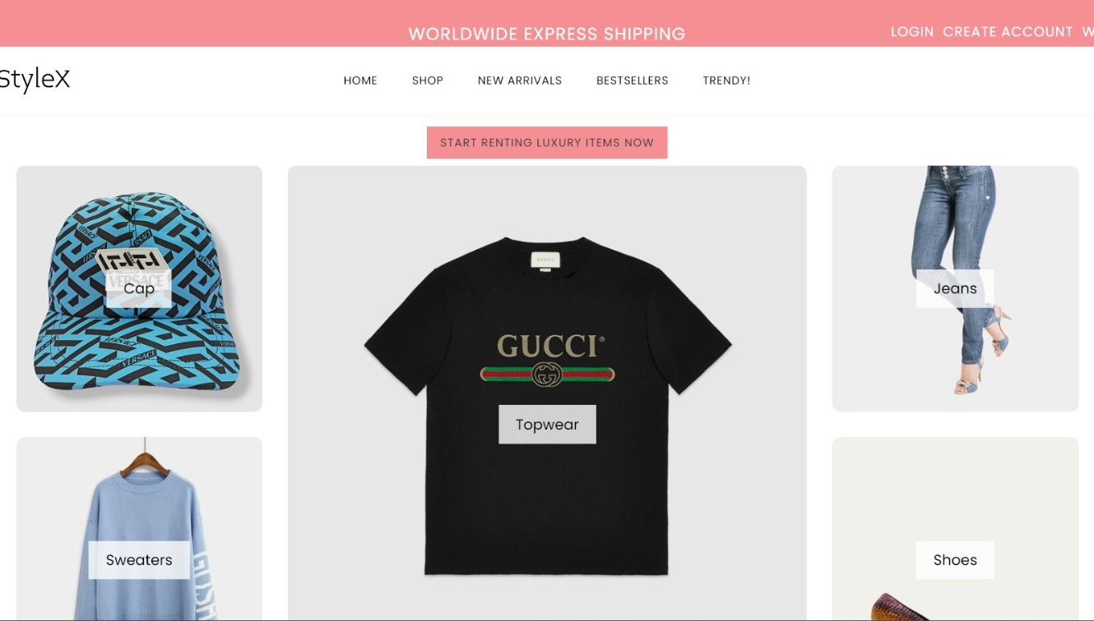
APPLICATION DEMO
PRANIT SOMIL

Slide 45


Slide 46
TEAM 1
GROUP 1
GROUP 2
PROJECT MANAGER - VINEET TAMHANE
PRODUCT OWNER – SHARATH VEMULAPALLY
BUSINESS ANALYST – SIVA SAI PALLA
LEAD DEVELOPER – VARSHA ANAND FNU
DEVELOPER – HONGHAO ZHU
LEAD DBA – SOMIL HARSHA SAPARIA
QA ANALYST – ANIRUDH UPPALURI
SOFTWARE TESTER – KUNJ DESH PATEL
PROJECT MANAGER - VENKATA SAI ROHITH
PRODUCT OWNER – KALPANA KOMATINENI
BUSINESS ANALYST – SAKSHI PANDIRKAR
LEAD DEVELOPER – GAURI GUPTA
DEVELOPER – RAM PRAKASH BABU
LEAD DBA – PRANIT KUMBHAR
QA ANALYST – DHIVYA ELANGO
SOFTWARE TESTER – NIKHIL GAVINI

Slide 47

Thank you!
STYLEX

